Slide 1
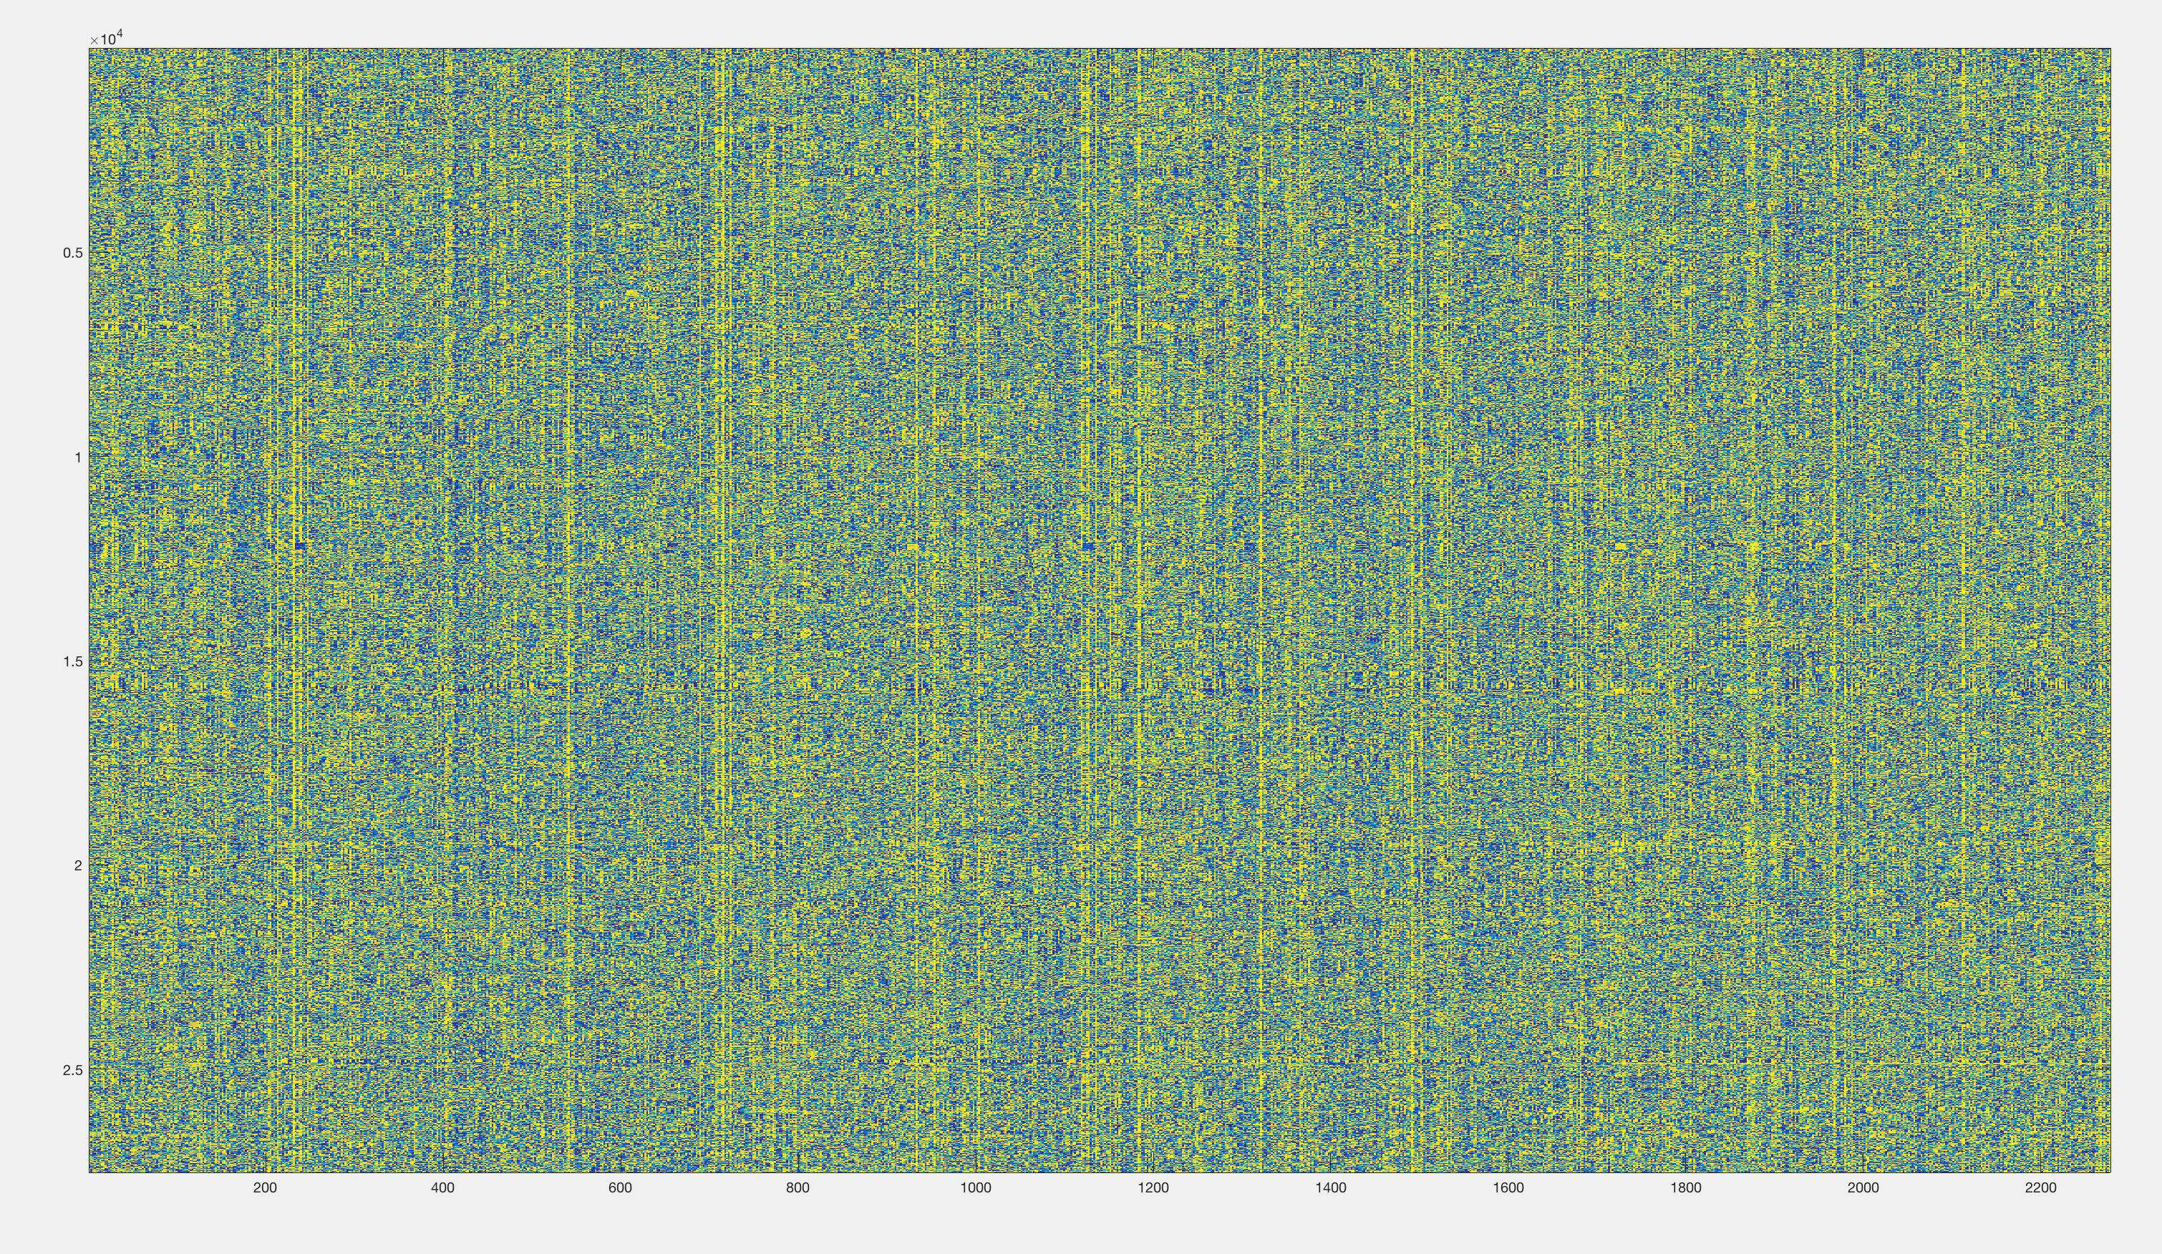
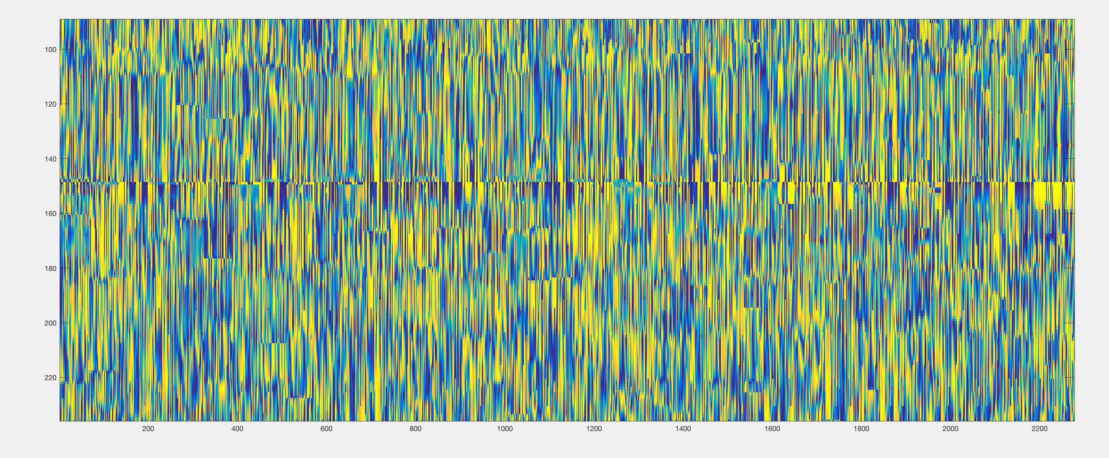
Phase locking matrix (phaselock_all)
Signatures for each
subject at each time
Diagonal entries
Subject 1
Subject 2

